Slide 1
Mission Possible
Calista Redmond
CEO, RISC-V foundation
@Calista_Redmond

Slide 2
Global innovation Global collaboration
Cloud and data center applications top cloud providers like Amazon and Alibaba are designing their own chips.
%.
Mobile and wireless continue rapid evolution with each generation of hardware and increased capability.
Automotive is transforming from autonomous vehicles to infotainment to safety, the whole vehicle relies on innovative electronics.
Consumer and IoT devices bring incredible innovation and volume with billions of connected devices being in the next 5-10 years.
Industrial IoT incorporating artificial intelligence in manufacturing and industrial processes.
Memory was the largest semiconductor category by sales with $158 billion in 2018, and the fastest-growing, with sales increasing
Notes:
Memory comment according to Semiconductor Industry Assoc SIA. Sales of DRAM products increased 36.4% and sales of NAND flash products increased 14.8%. Logic ($109.3 billion) and micro-ICs ($67.2 billion)—a category that includes microprocessors—rounded out the top three product categories in terms of total sales.

Slide 3
Notes:
The ecosystem is strong, and growing

Slide 4
RISC-V Europe leadership
A RISC-V fully European platform for space
Officially launched in October 2019, the Horizon 2020 European project De-RISC (Dependable Real-time Infrastructure for Safety-critical Computer) has gathered an international consortium to develop a hardware and software platform based around the RISC-V ISA for the space and aviation market. https://www.eenewseurope.com/news/risc-v-fully-european-platform-space
European Processor Initiative for Accelerator
The Accelerator stream will develop and demonstrate fully European processor IPs based on the RISC-V Instruction Set Architecture, providing power efficient and high throughput accelerator tiles within the GPP chip. Using RISC-V allows leveraging open source resources at hardware architecture level and software level, as well as ensuring independence from non-European patented computing technologies. https://www.european-processor-initiative.eu/accelerator/

Slide 5
Industry leverage of RISC-V
Embedded
Microchip Polarfire low power FPGA SOC for Military and aerospace applications requiring realtime, highly secure
Machine Learning / AI
Alibaba revealed 16-core high performance RISC-V chip for AI, IOT, and 5G applications. They have also shared a low-power RISC-V design
InCore Semiconductors of India laid out plans for a family of RISC-V based cores as well as deep-learning accelerators and SoC design
Sony Semiconductors detailed plans for AI integration onto image sensors at RISC-V Tokyo Day
SWITCH SCIENCE KK AI camera with RISC-V CPU, M5StickV (Japan)
High Performance Computing
The European Processor Initiative picks RISC-V for accelerators
Internet of Things
Greenwaves offers ultra-low-power, high-performance GAP8 APs to enable AI in battery-powered IoT devices. GreenWaves is a key contributor to the RISC-V–based PULP (parallel ultra-low-power processing platform)
GigaDevice launched world’s first general-purpose microcontroller based on RISC-V for the IOT market.
Virtual reality, augmented reality, AR/VR
Facebook’s Oculus team has been a strong supporter of RISC-V, sharing the importance of the technology in AR/VR application
Wearables
Huami’s Huangshan 1S Processor on 7nm. Huami is a top wearable manufacturer in the world today
Wireless
Samsung plans RISC-V cores in the mmWave RF portion of its 5G cellular modems
Notes:
Microchip https://www.militaryaerospace.com/computers/article/14074714/embedded-computing-fpga-lowpower
Alibaba https://www.eetimes.com/alibaba-reveals-16-core-risc-v-chip/
Gigadevice EE Times 26 Aug 2019
InCore EE Times July 2018
Samsung https://twitter.com/diodesign/status/1204482962072330240

Slide 6
Functional innovation on RISC-V
Acceleration
NVIDIA is expanding RISC-V beyond microcontrollers to input/output core in an inference accelerator part RC18, a high-performance accelerator for deep-learning inference workloads. Input output and serial functionality is handled by a single master core – built on the RISC-V ISA.
Memory and Storage
Western Digital has committed to use RISC-V in all of their storage processors
Macronix is bringing RISC-V memory centric solutions that combine memory with a RISC-V accelerator processor to consumer implementations
Security
HexFive creator of MultiZone™ Security for multi-domain secure execution environment for RISC-V, also an AdaCore partner
Microchip mid-range PolarFire FPGA for low power, thermal efficiency, and defense-grade security in embedded computing systems
Root of Trust
Google launched OpenTitan together with Western Digital, ETH Zurich, G+D Mobile Security, Nuvoton Technology for an open source microprocessor (the lowRISC Ibex, a RISC-V-based design), cryptographic coprocessors, a hardware random number generator, a sophisticated key hierarchy, memory hierarchies for volatile and non-volatile storage, defensive mechanisms, IO peripherals, secure boot, and more
Design support
Imperas and UltraSOC providing tools and verification support
Andes IDE for software development based on Eclipse for embedded applications.
SmartDV Technologies ,Verification IP supplier, TileLink VIP to verify the TileLink chip-scale interconnect standard.
AdaCore bringing Ada and Spark programming to RISC-V
Notes:
NVIDIA https://abopen.com/news/nvidia-turns-to-risc-v-for-rc18-research-chip-io-core/
Macronix https://www.forbes.com/sites/tomcoughlin/2020/01/13/storage-and-memory-at-the-2020-ces-part-2/#6a21b31d4052
Google https://www.scmagazineuk.com/google-looks-open-source-silicon-solve-root-trust-conundrum/article/1665164
DSA Domain-specific accelerators (DSAs) provide higher performance per watt than a general-purpose processor by optimizing the specialized function it implements. Examples of DSAs include compression/decompression units, random number generators and network packet processors.
Design https://www.eeweb.com/profile/max-maxfield/articles/introducing-risc-v-and-risc-v-tools

Slide 7
Software support
Open Source GNU toolchain, LLVM, QEMU virtual machines
Operating Systems
Linux high end (64 bit), Yocto (embedded distro) and OpenSuse
Fedora (Red Hat) support coming in 2Q 2020
AliOS, like Linux/Android from Alibaba for RV 64 bit
32 bit RTOS
FreeRTOS (AWS RISC-V Support in FreeRTOS Kernel for embedded IoT applications on supported kernel for microcontrollers)
Zephyr
VxWorks RTOS from Windriver now supports RISC-V for embedded
ThreadX (AndesCore)
SafeRTOS
SylixOS; an opensource embedded real-time operating system
RT-Thread; an open source RTOS for embedded
AliOS-Things; a 32 bit RTOS from Alibaba
Ubiquitous AI Corporation:TOPPERS-Pro/ASP RTOS
Commercial SW
Lauterbach
Segger
IAR
Micrium
ExpressLogic
Ashling
Notes:
SafeRTOS (this is a cool one; https://www.prweb.com/releases/safertos_now_supports_risc_v_a_new_announcement_from_wittenstein_high_integrity_systems/prweb16443406.htm)

Slide 8
The community and marketplace of open hardware
RISC-V Alliances
Linux Foundation
Pakistan
RISC-V Japan Alliance
ChipsAlliance
FOSSi Foundation
RIOS Lab
Taiwan RISC-V Alliance (RVTA)
OpenForum Europe (OFE)
GlobalPlatform
OpenHW Group
CRVA (China)
CRVIC (China)
Beijing Open Source Silicon Innovation Center
Cores and SOCs
Rocket. UEC Pham Lab. 64-bit Rocket U5 Chip
BOOM from Berkeley
Ariane 64 bit CPU from ETH Zurich
Piccolo CPU for embedded and IOT from Bluespec
Out-of-order superscalar processor RSD from University of Tokyo
Ibex 32 bit RISC-V CPU core from lowRISC
SweRV core open sourced from Western Digital
zGlue release rapid turnaround chiplet-based GEM ASIC from AntMicro
RISC-V Cores
RISC-V commercial IP core providers: SiFive, Andes Technology, Codasip, Bluespec, Cortus, Cloudbear, Nuclei
In-house cores: Esperanto, Western Digital, NVIDIA, Alibaba
List online: www.riscv.org/risc-v-cores
Additional open and proprietary
SiFive
Andes
Rumble Development
Esperanto
Greenwaves
NXP
GigaDevice
Microchip
Notes:
UEC Pham Lab. 64-bit Rocket U5 Experimental Chip Japan

Slide 9
2020 Europe Events
Embedded World (Feb 2020 Nuremberg)
Pavilion of numerous RISC-V members, talks, reception
https://www.embedded-world.de/en
First EPI forum Paris (Mar 2020 Paris)
Discussions and speakers on progress of the first year of the European Processor Initiative.
https://www.european-processor-initiative.eu/event/first-epi-forum/
Supercomputing Frontiers (Mar 2020 Warsaw)
Trends and innovations in high performance computing and computational science.
https://supercomputingfrontiers.eu/2020/
FOSSistanbul (Mar 2020 Istanbul)
Free and open source Silicon discussions and talks.
http://fossi-foundation.org/fossistanbul/
ISS Europe (Apr 2020 Brussels)
Semiconductors Enabling a Digital, Secure and Sustainable Future
https://www.semi.org/eu/connect/events/Industry-Strategy-Symposium-Europe
DV Con Europe (Oct 2020 Munich)
Tutorial on RISC-V Design and Verification
https://dvcon-europe.org
More to be confirmed!
Events are currently being added to the www.riscv.org website
Notes:
Contact info@riscv.org to add events to our list

Slide 10
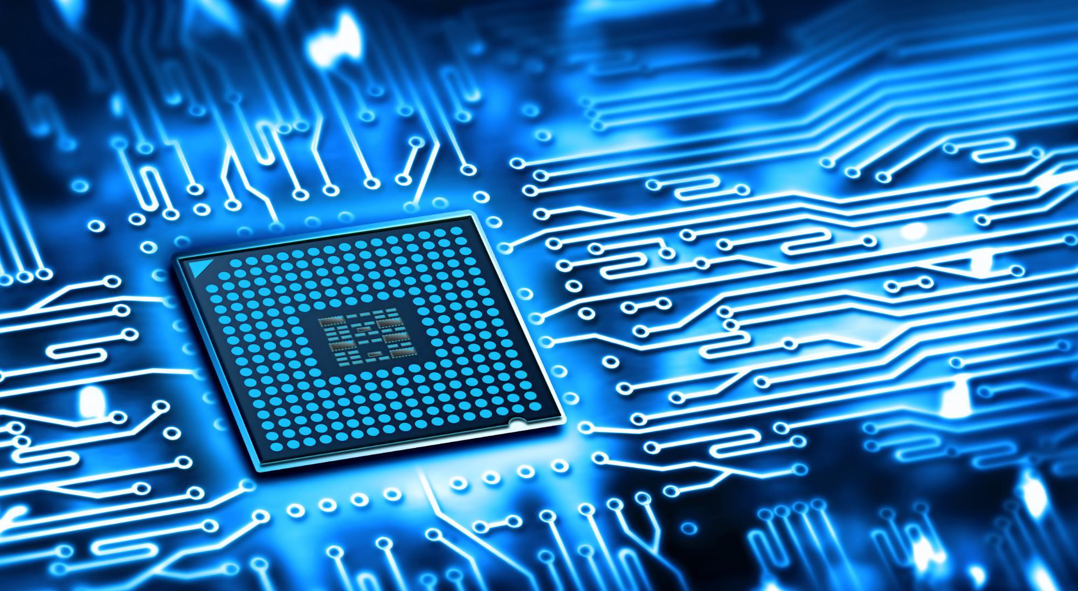
Calista Redmond
CEO , RISC-V Foundation
www.linkedin.com/company/risc-v-foundation
www.linkedin.com/in/calistaredmond
Join the Revolution
@risc_v
@Calista_Redmond
www.riscv.org

